Slide 1
Loan Approval Insights
Report By Vivek Pradhan

Slide 2
Insights
Form the Pie chart we can draw higher the education lower the interest rate. This mean that education is inversely proportional to interest rate. People with higher education may have higher knowledge of finance and money management with experience than the people with low education.
Loan amount density is higher with Male as compared to Females.
Loan amount is higher for Education, Medical and Ventures which is uniform for both male and female where male loan amount is higher.
Scatter plot interprets higher income leads to higher expenditure where the loan status is higher on people with ‘low income’ and ‘high expenditure’.
Higer person income shows low ‘close’ status of loan amount where the loan interest rate was high.
People with higher loan defaults has “close” loan status.

Slide 3
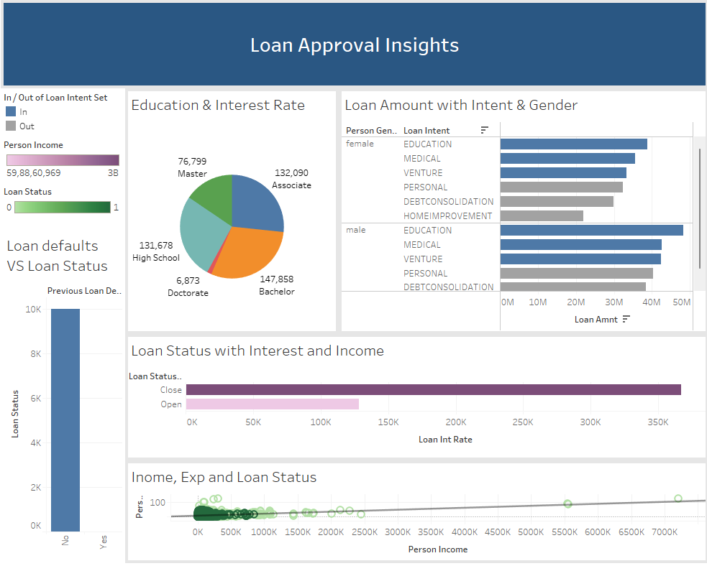
Dashboard

